Slide 1
Unleashing Application Deployment Brilliance with Intune
Workplace Ninja's Danmark

Slide 2


About Anders Green
Blog
Focus
HTTPS://blog.devicemetal.com
Intune, Windows 365 and T2T
Hobbies
From
MTB, Music, Home automation, CrossFit
Sweden
Contact
X
anders.green@exobe.com
@green_anders

Slide 3
In this session…
Pushing apps from Intune
What options do we have “for free”?
Challenges
Apps that gives you headache
PS App deployment Toolkit to the rescue
How I work with PSADT
My pain, Virtualcom
Another headache permissions, install and copying files

Slide 4

Pushing apps from Intune
Easily handle all your apps from a single place.
Keep your app data safe and control who accesses it.
Manage apps on any device, whether it's Windows, iOS, Android, or macOS.
Ensure all apps meet your company’s rules and generate necessary reports.
Make life easier for users with self-service and automated updates.
Cut costs by streamlining app management and reducing downtime.

Slide 5
Lets talk Windows apps….

Slide 6

What options do we have?
Windows store
Line of business (MSI,MSIX,APPX)
Win32App
Intune Enterprise Apps
3rd party tools for deployment and management
Scripting with external sources (PowerShell, remediation)

Slide 7

Challenges
MSI or single exe Syntax of the installer. No or few modifications (MST)
Updating apps Jabra, Google, legacy apps
Dependencies .Net anyone?
Conflicting apps Java versions
Apps needs to be installed in interactive mode with or without interaction

Slide 8
Win32App vs LOB (MSI)
Win32 apps allow for more complex and customized application packages, supporting a wide variety of installation scenarios and dependencies.
You can include PowerShell scripts for pre-installation, post-installation, and detection logic, providing greater control over the installation process.
Provides detailed installation status and error reporting, aiding in troubleshooting and ensuring successful deployments.
Supports a wider range of applications, including legacy apps, and allows for the installation of MSI, EXE, and other installers.
Allows for more interactive installations, giving users options and prompts during the installation process.
Easier to create and deploy, making it suitable for straightforward app installations with minimal customization needs.
Generally, results in faster deployments due to smaller package sizes and simpler configurations.
Easier for administrators to manage, especially for less complex app deployment scenarios.

Slide 9
Win32App vs LOB (MSI)
Win32 apps allow for more complex and customized application packages, supporting a wide variety of installation scenarios and dependencies.
You can include PowerShell scripts for pre-installation, post-installation, and detection logic, providing greater control over the installation process.
Provides detailed installation status and error reporting, aiding in troubleshooting and ensuring successful deployments.
Supports a wider range of applications, including legacy apps, and allows for the installation of MSI, EXE, and other installers.
Allows for more interactive installations, giving users options and prompts during the installation process.
Easier to create and deploy, making it suitable for straightforward app installations with minimal customization needs.
Generally, results in faster deployments due to smaller package sizes and simpler configurations.
Easier for administrators to manage, especially for less complex app deployment scenarios.
I never user LOB!

Slide 10
Apps that makes life uneasy
Needs specific extra files like license or configuration files
Set folder permisisons before or after install
Non installers i.e. Not silent whatsoever
Registry settings
Dependencies, plain or built in
Installs in user context but with admin priv

Slide 11
PS App deployment Toolkit to the rescue
“PSAppDeployToolkit is a versatile solution that streamlines and standardizes the process of software deployment,
making it easier than ever to manage your IT environment.
It has a comprehensive set of features, such as dynamic logging, user interaction capabilities, and customizable functionality.”
A script kit that extends the possibilities for deploying applications in Intune. Comes with perfect logging features and a set of functions to make it easier to customize all app installations.

Slide 12
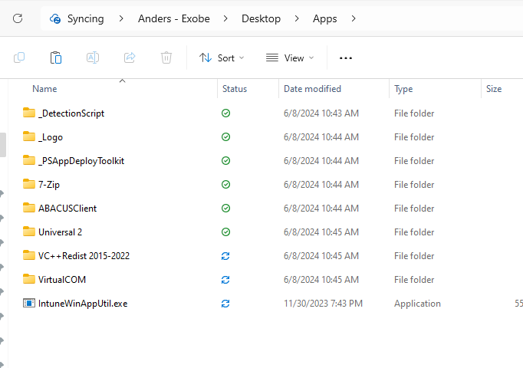
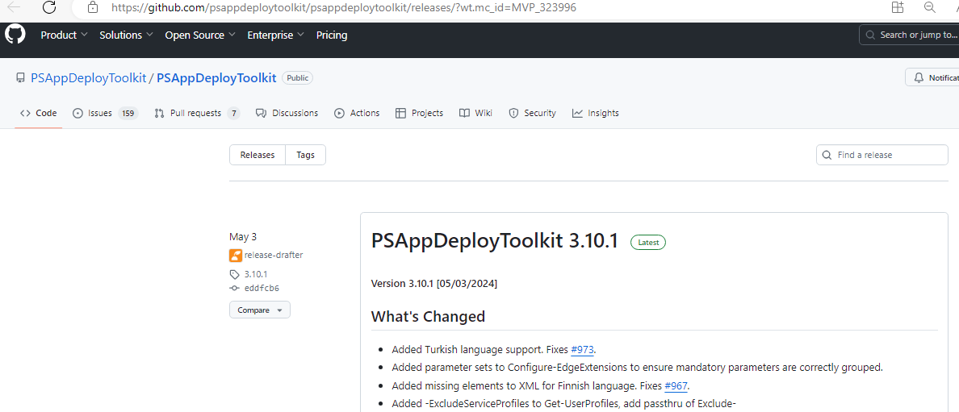
PS App deployment Toolkit to the rescue
Create a nice folder structure to work in
Download Content Prep Tool, copy intunewinapputil.exe and into the root
Get the latest PSADT from Github: Powershell App Deployment Toolkit
Customize the toolkit - set log path, change icons and banners
Fill the folder structure with your apps.

Slide 13
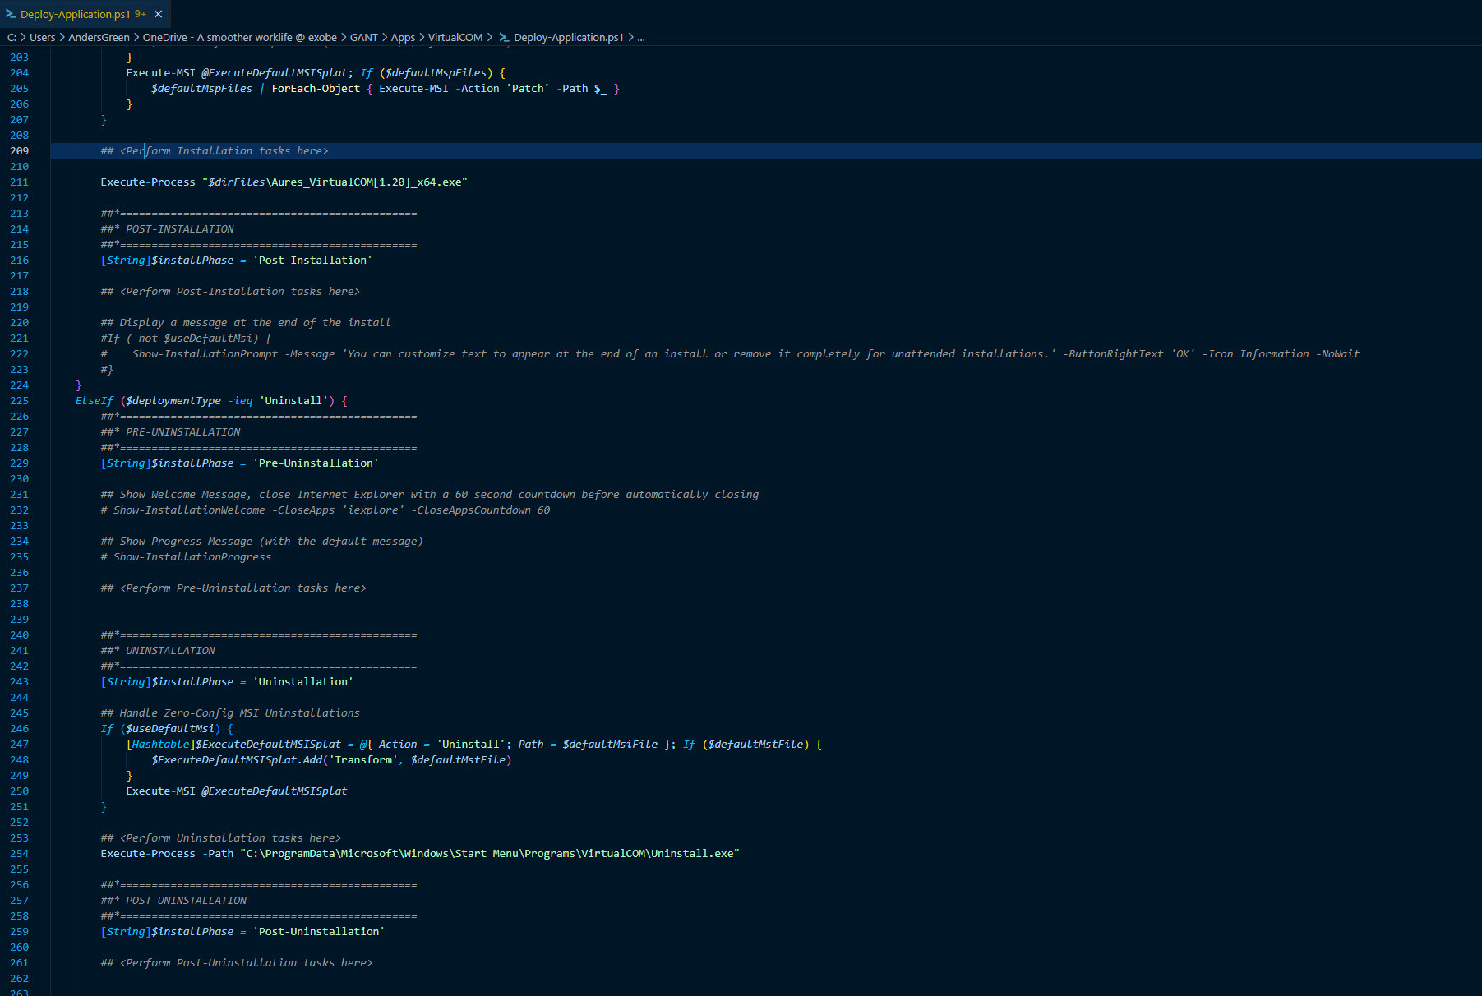
A virtual COM to USB port driver…. Needs to run in user context

Slide 15
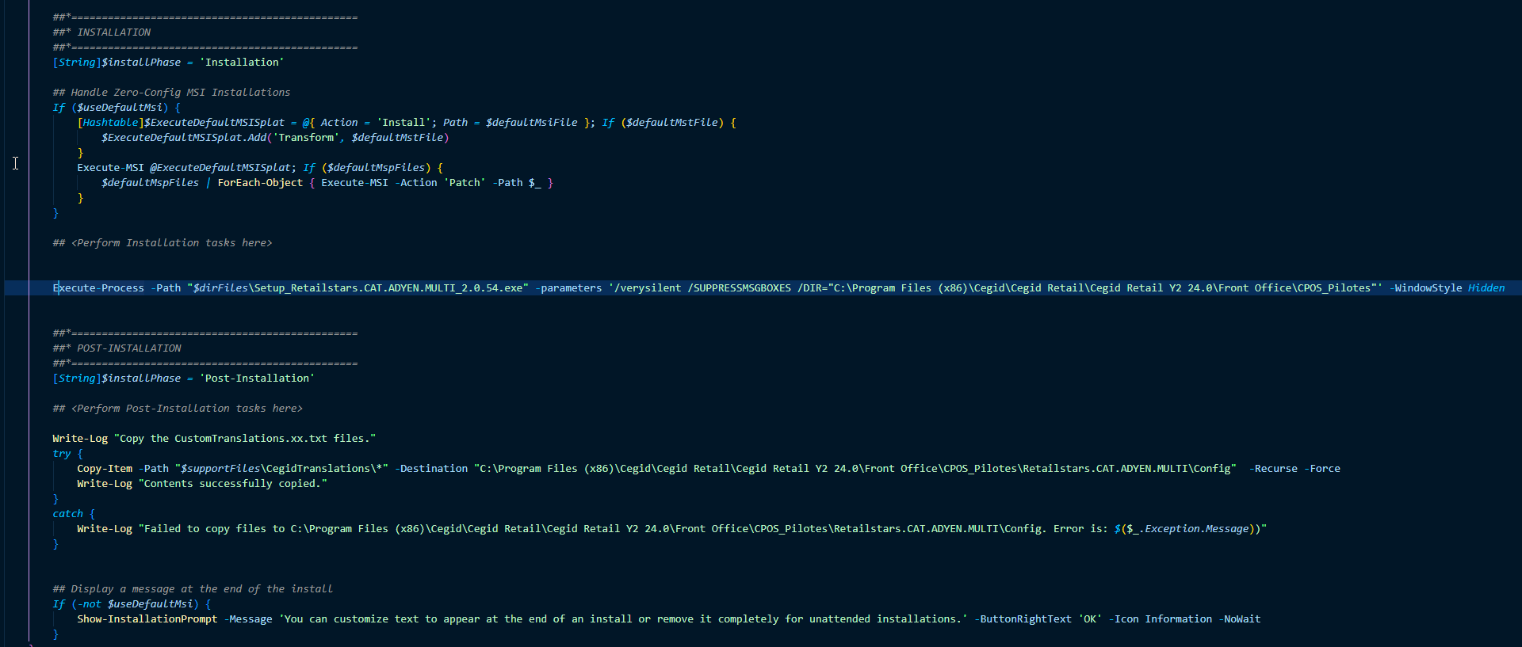
I need more things…

Slide 20

Preparing the package and working with PSADT

Slide 21
Prepare Intune for Deployment
Wrap the folder with Content prep tool
Add package to Intune as Win32App
Configure the basics i.e Logo and other information
Set the install and uninstall commands
%windir%\sysnative\WindowsPowershell\v1.0\powershell.exe -ExecutionPolicy Bypass -File ".\Deploy-Application.ps1" -DeploymentType "Install" -DeployMode "Silent“
%windir%\sysnative\WindowsPowershell\v1.0\powershell.exe -ExecutionPolicy Bypass -File ".\Deploy-Application.ps1" -DeploymentType "Uninstall"
.\ServiceUI.exe -Process:explorer.exe Deploy-Application.exe
.\ServiceUI.exe -Process:explorer.exe Deploy-Application.exe Uninstall
ServiceUI.exe - a tool included in the Microsoft Deployment ToolKit. Used for forwarding System Context dialog options to the user desktop

Slide 22
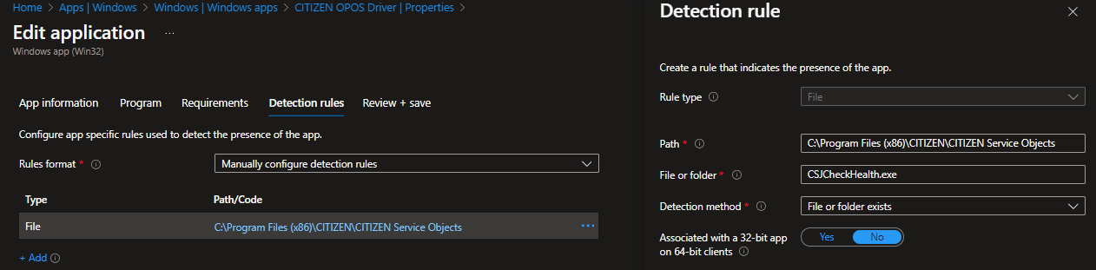
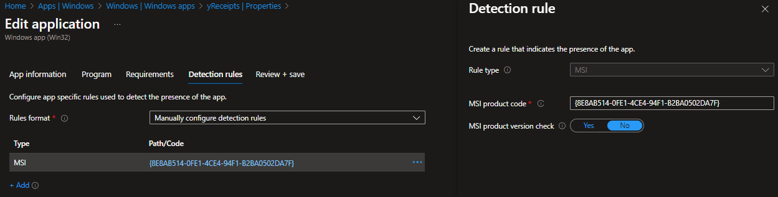
Prepare Intune for Deployment
Configure Detection Remember dependencies or customizations like file copy. Might require detection script
Pick your targets Think about the autopilot time. Service or self-service?

Slide 23

Adding the package to Intune

Slide 24

Some advice..
Use PS App Deployment Toolkit whenever there is something messy or just for rocking the app deployment
Simple MSI that is done properly, stick to just wrapping it
Always use win32app instead of LOB
Keep the app folders
Use a dedicated device or a virtual device to test the deployments. Should be a normal user device
More or less, everything goes ☺

Slide 25

Questions?

